Slide 1

Tenant Leaders and Nonpartisan Election Engagement
Courtney Cooperman (she/her), project manager, NLIHC

Slide 2

About Our Homes, Our Votes
NLIHC’s nonpartisan campaign to boost voter turnout among low-income renters and people experiencing homelessness, and to elevate housing as an election issue
Empowers tenant leaders, advocates, and direct services organizations to register, educate, and mobilize voters

Slide 3
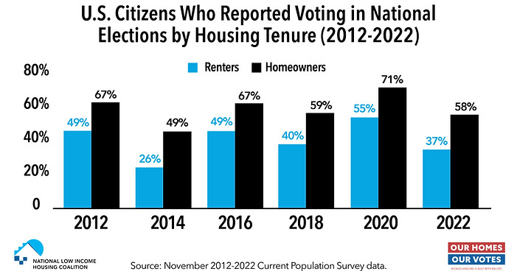
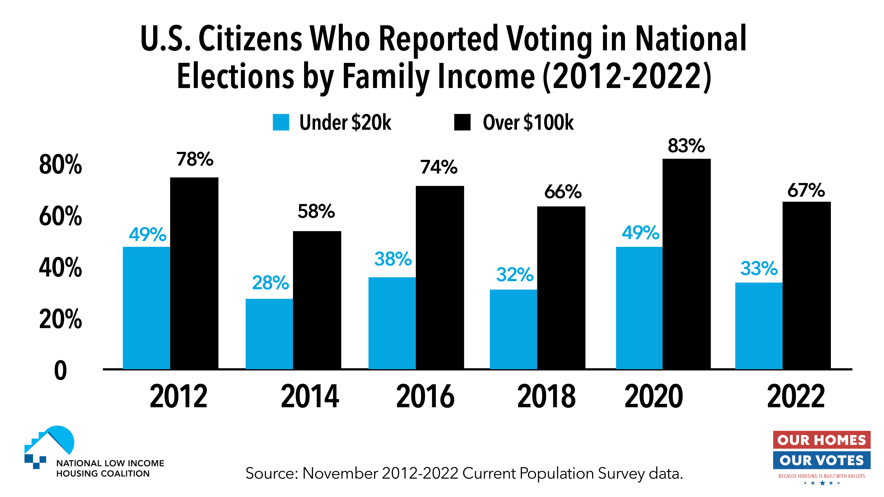
Voter Turnout Disparities

Slide 4
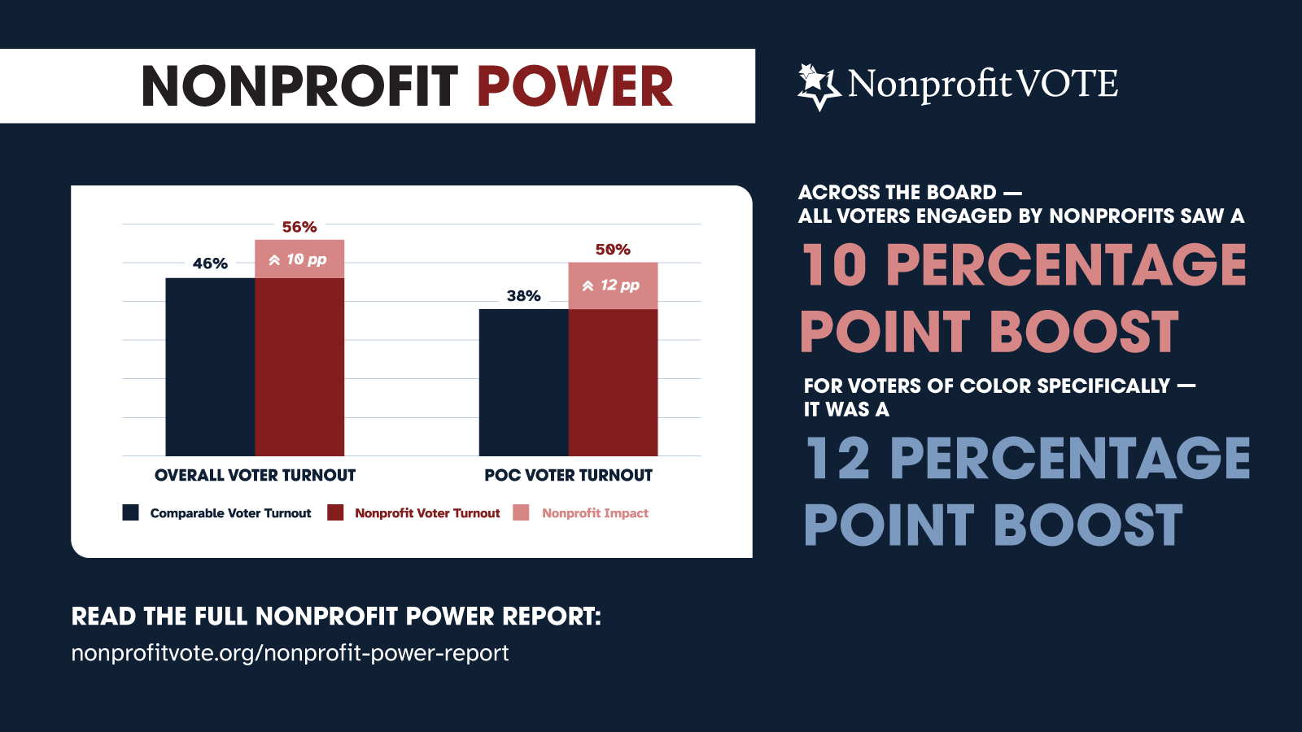
Trusted Messengers Can Make the Difference!

Slide 5




Building Blocks of a Nonpartisan Voter Engagement Campaign
Voter Education & Candidate Engagement
Voter Registration
Voter Mobilization
Voter Protection
Distribute info about Election Protection Hotline
Inform voters about provisional ballots
Voter ID clinics
Candidate forums + questionnaires
Nonpartisan voter guides
Signs & messages about deadlines, polling places, etc.
Reminder phonebanking or textbanking
Canvassing
Transportation
Post-Election celebration
Make forms available
Tabling
Canvassing
Voter registration events

Slide 6
Resident Councils and Voter Engagement
“Executive Order on Promoting Access to Voting” directs federal agencies to facilitate voter registration & encourage voting
Public Housing Agencies are permitted—and actively encouraged!—to organize nonpartisan voter engagement activities
Where PHAs fund Resident Councils, they may use funds to provide transportation to the polls as a resident service
  Consult with PHAs to determine whether funds can be used for additional voter engagement activities

Slide 7
What is Allowed?
Share nonpartisan voter and election resources with residents
Permit use of community space to hold meetings, nonpartisan candidate forums, and voter registration
Collaborate with local election administrators to use space for voter drop boxes and voting sites
PHAs: documentation of residence; apply to operate as voter registration agency; make forms available, accept and transmit completed forms, run PHA-initiated voter registration drives (where permitted by state law)

Slide 8

What is Prohibited?
Partisanship!!!
Favoring one candidate over another. This includes inviting one candidate to a forum without providing the equal opportunity for others to attend
Tying voter registration to the electoral prospects of any party/candidate
Use of facilities for partisan activities (ex: phonebank for a candidate, rather than nonpartisan get-out-the-vote)
Giving the impression that benefits are tied to a resident’s voting activity, or that registration and voting are not voluntary
Ex: hosting an Election Night party and only inviting or offering rewards to those who voted

Slide 9



Nonpartisan Candidate Engagement
Bringing housing and homelessness into the spotlight
Laying the groundwork for effective advocacy
Building voter knowledge and enthusiasm

Slide 10
How to Engage Candidates as a Tenant or Resident
Host nonpartisan candidate forums in your building
Attend another organization’s nonpartisan candidate forum and ask a question
Invite candidates to community events
Circulate a nonpartisan candidate questionnaire
Write a letter to the editor in your local paper
Post on social media and tag candidates

Slide 11

Our Homes, Our Votes Educational Resources
Comprehensive online resource library
  Visit: https://www.ourhomes-ourvotes.org/resources
Biweekly webinar series
  Register: www.ourhomes-ourvotes.org/webinars-2024
  Next webinar: Monday, September 16: Voter Education—The Who, What, Where, When, Why, and How

Slide 12
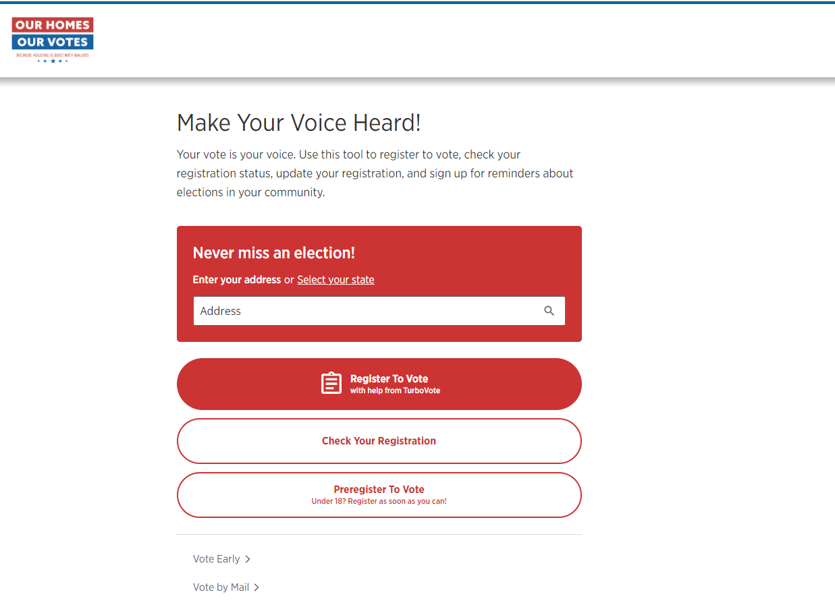

OurHomes.TurboVote.org

Slide 13
Affiliates Network
Open to all nonpartisan organizations that share campaign’s goals
Regular office hours, email listserv, and post-election virtual gathering
TurboVote referral codes
Sign up: www.ourhomes-ourvotes.org/affiliates

Slide 14
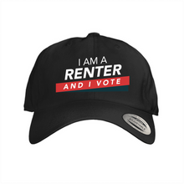

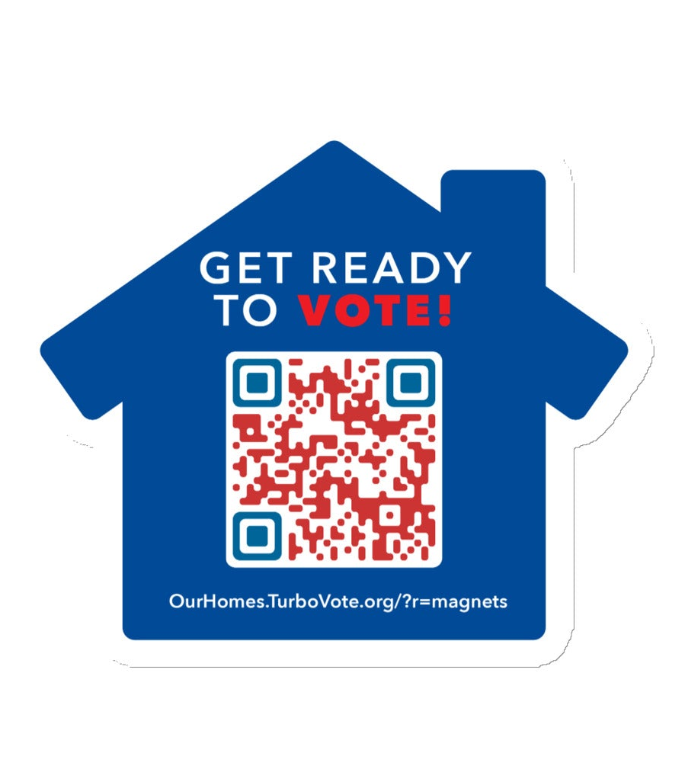

Our Homes, Our Votes Swag
Visit https://nlihc.myshopify.com/

Slide 15
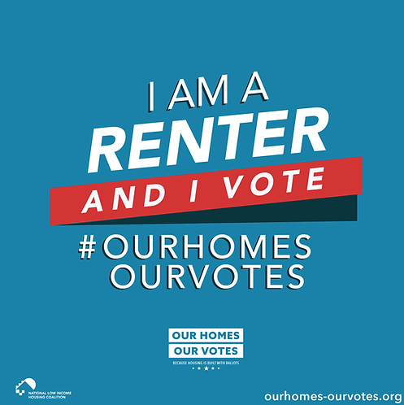
Questions?
Email: ccooperman@nlihc.org

