Slide 1

NLIHC’s Training Institute
Organizing 101:
Community Organizing & Power Building
May 29, 2025
Tori Bourret

Slide 2
Agenda
Welcome & Intro
Dee Ross, Tenant Leader Fellow, NLIHC
Organizing 101
Billy Cerullo, Housing Advocacy Organizer
Tia Turner, Housing Advocacy Organizer
Next Steps
Dee Ross, Tenant Leader Fellow, NLIHC

Slide 3
Welcome & Intro
Dee Ross
Tenant Leader Fellow
National Low Income Housing Coalition

Slide 4
Organizing 101
Billy Cerullo
Housing Advocacy Organizer
National Low Income Housing Coalition
Tia Turner
Housing Advocacy Organizer
National Low Income Housing Coalition

Slide 5
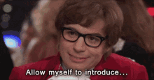
Introductions

Slide 6
Agenda
Power Poll
Advocacy vs. Activism vs. Organizing
Defining Organizing and Power
The Cycle of Organizing
Closing and Q&A

Slide 7
Goals
To give a basic overview of organizing
To learn the definition of power
To learn the cycle of organizing to apply to your own work

Slide 8
Poll: Is power good, bad, or neutral?

Slide 9
Intro to Organizing

Slide 10
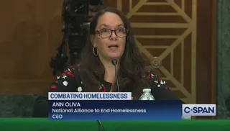
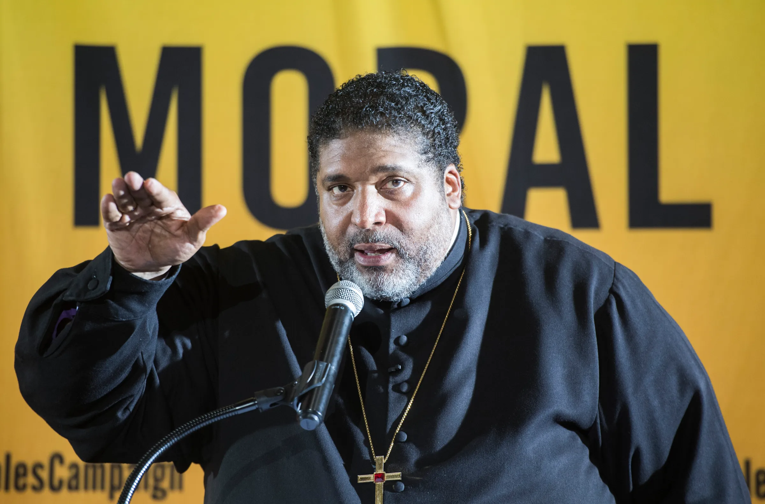
Advocacy and Activism
Advocacy
Activism
Speaking on behalf of others
Oftentimes lawyers, policy folks, researchers, etc.
Individual-centered
More niche and (maybe) elite
Usually charismatic figures

Slide 11
Organizing
Organizing: Organized people around shared self-interest and a common goal to build and exercise power to shape politics, policies, and outcomes
Self-Interest: what motivates people to act (or not act)
Power: The ability to act and achieve purpose
  Power is neutral
Political power comes in two forms - organized people and organized money
Ex: labor unions (local and national), NRA, Planned Parenthood

Slide 12
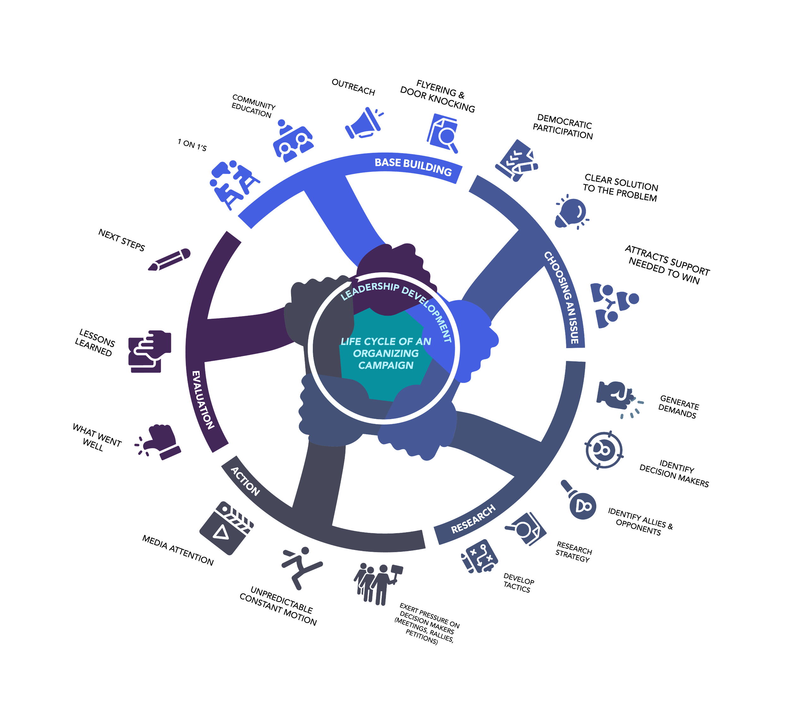
Cycle of Organizing

Slide 13
Base Building

Slide 14
Base Building
Principle of Organizing: Power in relationships
“Who are your people?” – Ella Baker
Questions to consider:
  How much power do we need?
  What does power in numbers look like?
  How many people do I want on my central organizing committee?
Principle of Organizing: Organizers teach leaders, leaders organize

Slide 15
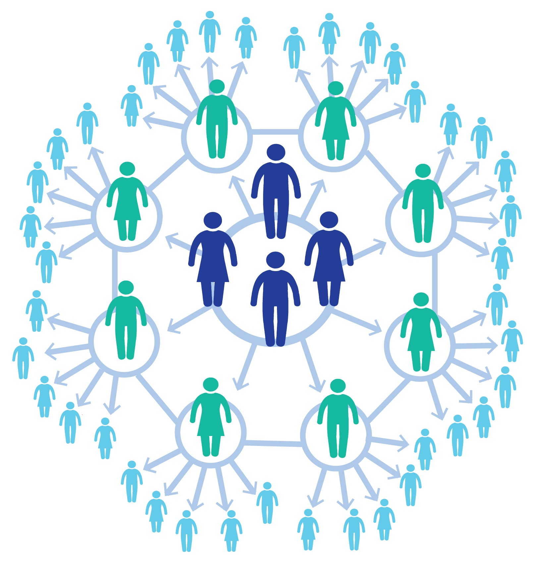
The Snowflake Model
The snowflake model is a way to organize teams that replaces a single leader with a team of interconnected leaders
The success of the team depends on developing leadership throughout the team

Slide 16
Choosing an Issue

Slide 17

Choosing an Issue
Problems vs Issues
Problems=big and overwhelming. Not effective goals
Issues=bite-sized pieces of the larger problem that help us chip away at societal exploitation

Slide 18
Example
Problems vs Issues
Problem: Homelessness
Issues: Funding for COCs, just cause policies, defeating homelessness criminalization bills, increased funding for public housing

Slide 19
Effective Goals
Qualities found in Ineffective Wants | Qualities of an Effective Want
Fixes/ends a vague or general problem | Pursues a specific solution to an issue
Centers a symptom (cosmetic change) | Centers a root cause of an issue
Does not address concrete issue in people’s lives | If achieved, results in concrete change in people’s daily lives
Is in someone else’s power to achieve | Your people have specific power to achieve it
Can be achieved through your actions alone | Will be achieved through the work of many
Achieved through cultural shift | Achieved through policy change or systemic change- concrete policies or protections

Slide 20
Research

Slide 21
Research
Who are my targets?
  Primary target
  Secondary targets
What is the policy surrounding our issue?
What will it take to win?
What has been done in the past?

Slide 22
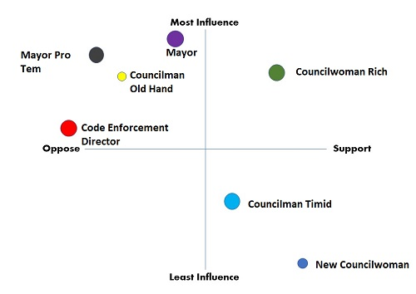
Power Mapping

Slide 23
Action

Slide 24
Actions
Effective | Ineffective
We ask “who” / the right people | We might ask “what” / how many people
The means to an end | The end within itself.
Follow up: the program is just the beginning. | Follow up: when it’s over, it’s over.
In evaluating, we look for the reaction | In evaluating, we might look at logistics
We get something new – a reaction: new leaders, interest, energy, possibilities, new thinking | We might get exhaustion & burnout
We’re working towards fixing things that are broken | At best, we’re learning about what’s broken

Slide 25
Evaluation – Did we win?
Why or why not?

Slide 26
Cycle of Organizing

Slide 27
Recap
Power is neutral
The cycle of organizing is your roadmap for any successful organizing campaign
There are distinctions between advocacy, activism and organizing.

Slide 28
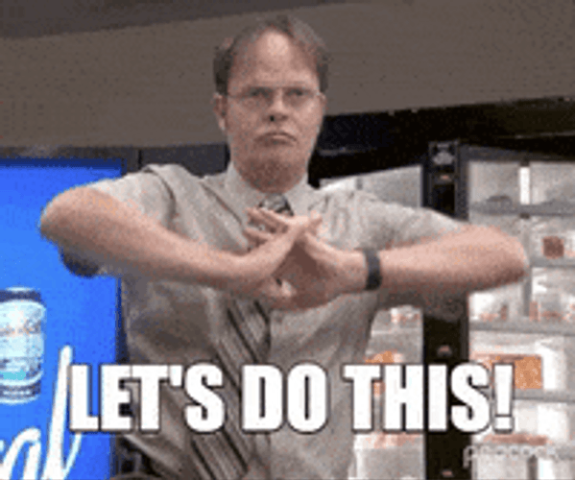
Next Steps
Where do you want to go?
What additional training/resources do you need?

Slide 29
Stay in touch!
Billy Cerullo and Tia Turner
Housing Advocacy Organizers
National Low Income Housing Coalition
wcerullo@nlihc.org| tturner@nlihc.org

Slide 30
Next Steps
Dee Ross
Tenant Leader Fellow
National Low Income Housing Coalition

Slide 31
Upcoming Courses
Fundraising & Sustainability 101
This session will teach sustainable fundraising strategies like grassroots campaigns, grant writing, and donor engagement. Participants will learn how to secure funding, grow tenant-led advocacy efforts, and effectively use resources to support long-term impact.
Marketing & Branding 101
Discover how to craft powerful messages, build a strong brand, and amplify the voices of tenant-led movements. This session will guide you in using social media, storytelling, and visual identity to raise awareness, attract support, and grow your impact.

